Slide 1
One repo for all with Azure DevOps
A presentation by
Kamil Mrzygłód
* See slide notes for page directions
Notes:
When listing all project collaborators, either use commas or bullets

Slide 2
About me
Senior Software Developer @ Demant
Located Warsaw, Poland
Trainer & Consultant
Books author
Microsoft Azure MVP

Slide 3
Question!

Slide 4
What’s a repo(sitory)?

Slide 5
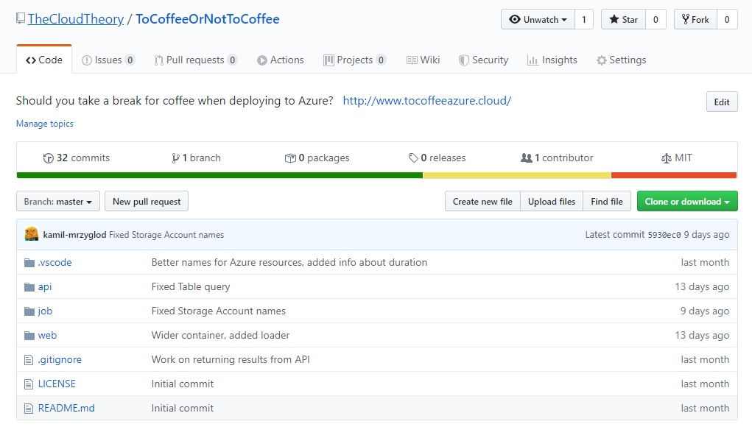

Slide 6
A repo
Source of truth for our codebase
Source for our build pipelines
History of a project
Auditing tool
Ultimate value of a project

Slide 7
What’s a monorepo?

Slide 8
Repository
Project A
Project B
Project C

Slide 9
Comparison
Common and standard pattern, especially for microservices
Handled individually by a dev team or a dedicated person
Scoped to a single project, not need to granular access to various components
Easy to Build
Represents only a tiny bit of a system
Sharing functionality actually involves additional component to make it functional
Aggregates multiple features of a common application(platform)
Requires a dedicated team managing a repository
Might be tricky to actually prevent someone from changing a particular feature
Represents the whole system but often involves a multi-step build pipeline
Easy to share you work with others

Slide 10
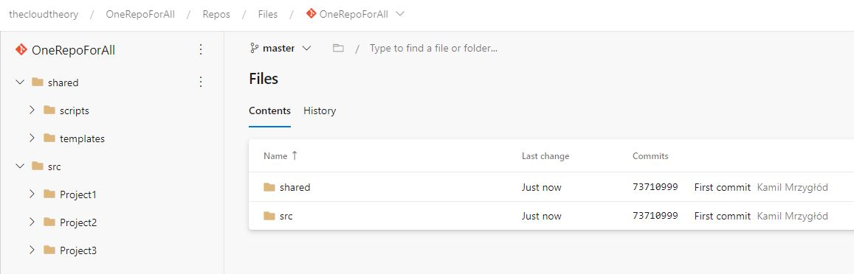
How does monorepo may look like?
Notes:
Insert a map of your colony (draw it, ink it, or create it in PPT- be creative!)
Insert -> Pictures for photos
Draw for digital inking
Insert -> Shapes if you want to create it in PPT
All mountains, towns/villages, bodies of water/waterways, landmarks, etc. should be clearly labeled

Slide 11
YAML pipelines?

Slide 12
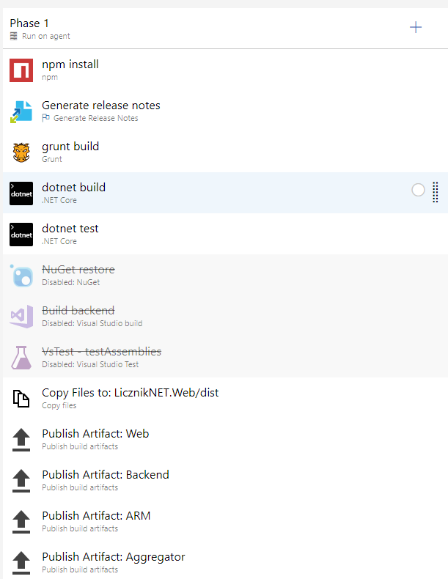

Slide 13
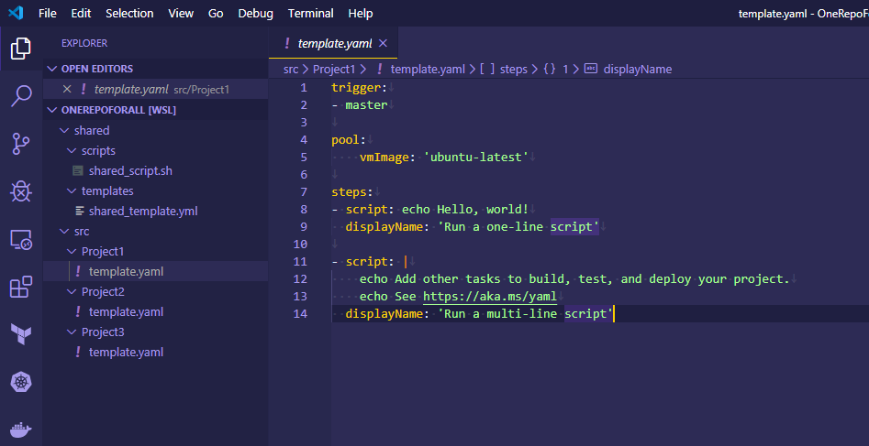

Slide 14
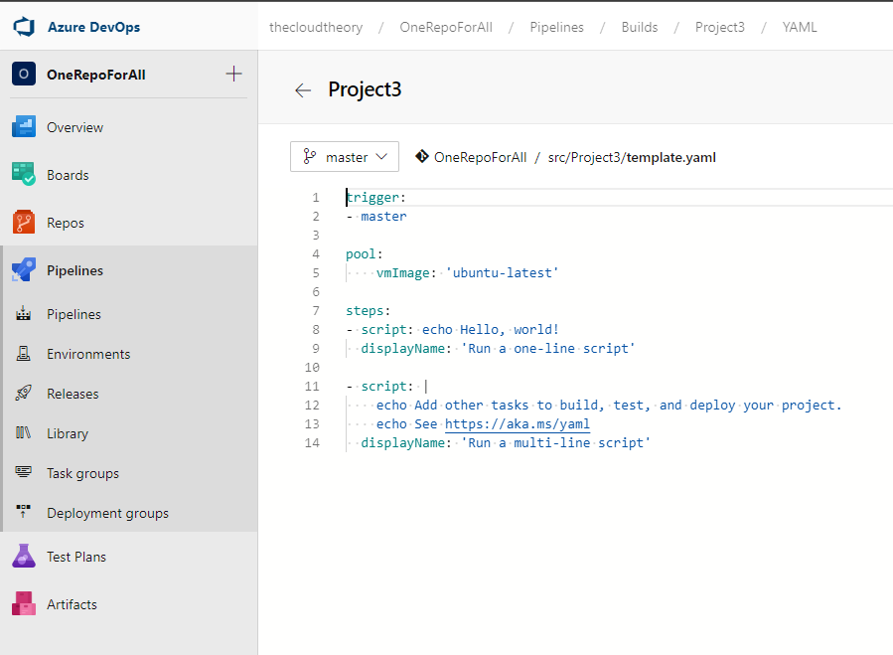

Slide 15
YAML vs Classic pipelines
YAML
Classic
Written in YAML
Easy to version
Easy to share
Consolidate whole application lifecycle
Can be easily extended using shared templates
Developed with GUI(with underlying JSON representation)
Versioning is really tricky
Sharing requires import/export functionality
Based on separate build/release pipelines
Can be extended via Task Groups

Slide 16
Why YAML pipelines for monorepo?

Slide 17
Templates

Slide 18
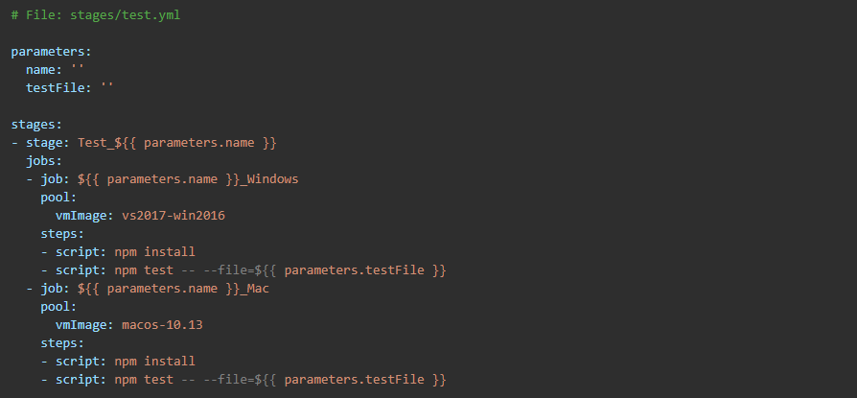
Stage template
Reuse a whole stage functionality(highest level)

Slide 19
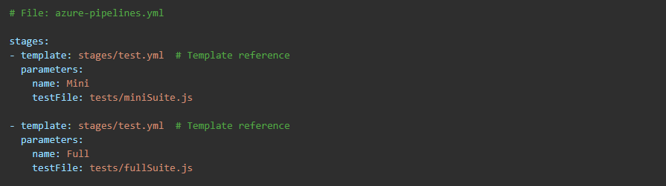
Stage template
Reuse a whole stage functionality(highest level)

Slide 20
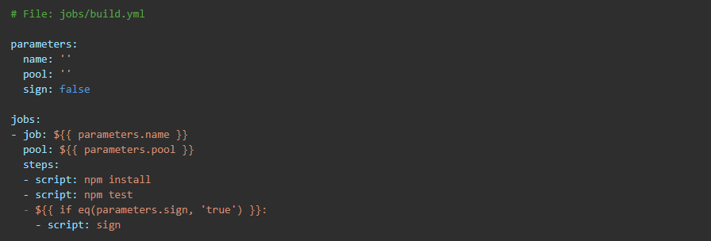
Job template
In a single/multiple stages reuse a particular functionality(e.g. installing dependencies)

Slide 21
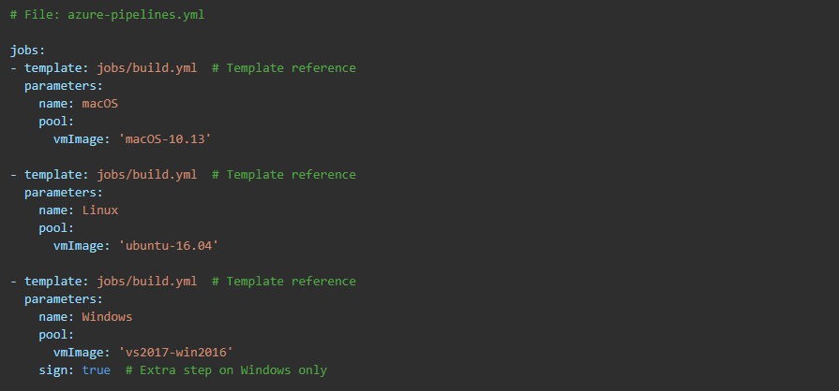
Job template
In a single/multiple stages reuse a particular functionality(e.g. building an application)

Slide 22
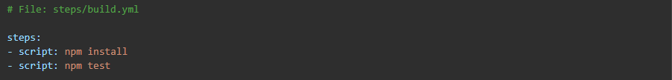
Steps template
Reuse only a subset of functionalities(e.g. installing dependencies & testing)

Slide 23
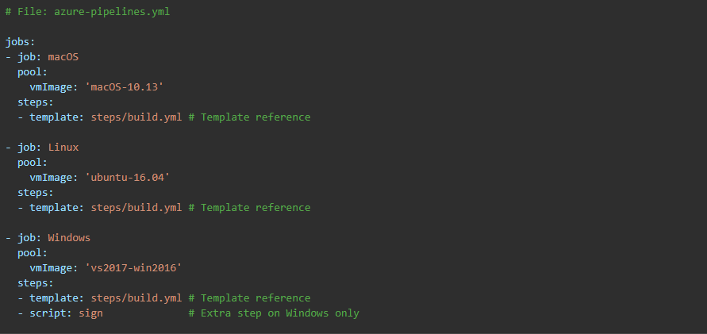
Steps template
Reuse only a subset of functionalities(e.g. installing dependencies & testing)

Slide 24
Policies, Environments & Approvals

Slide 25
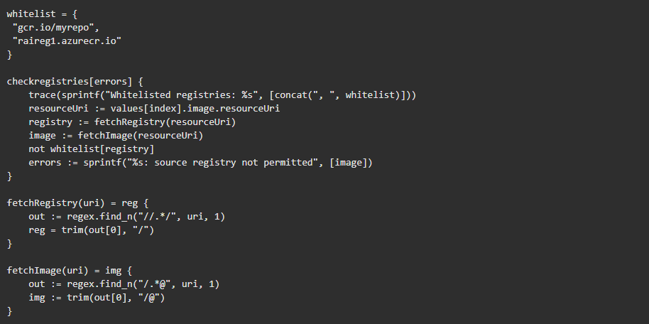
Policies
Currently scoped only to container images and Kubernetes environments. Written in Rego.

Slide 26
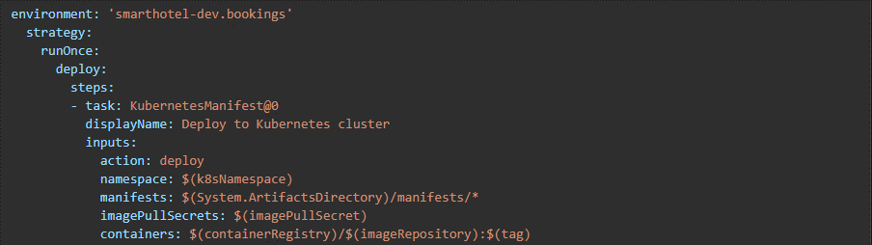
Environments
Environments links information about deployment with steps performed while running the pipeline. They allow also for a resource linking(Kubernetes namespace, VM).

Slide 27
Approvals
Environments links information about deployment with steps performed while running the pipeline. They allow also for a resource linking(Kubernetes namespace, VM).

